Slide 1
Image Source: http://www.antonin-dvorak.cz/images/zahlavi/zahlavi_zivotopis.jpg
Symphony 6
Movement 3
“Furiant”

Slide 2
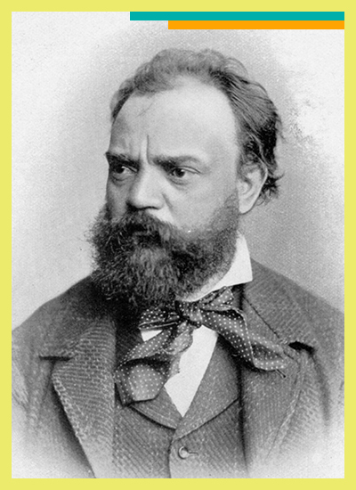
Image Source: https://d15gc4eof6ew0j.cloudfront.net/img/DSO%20Kids/composers/Border-%20Revised/DVORAK-romantic.jpg
Antonin Dvorak
1841-1904

Slide 3
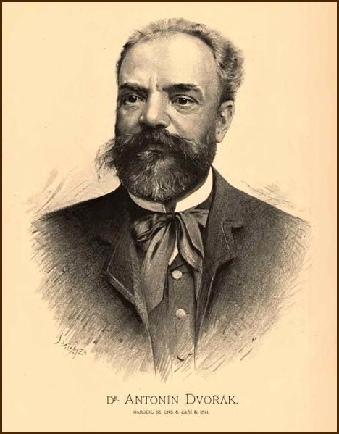
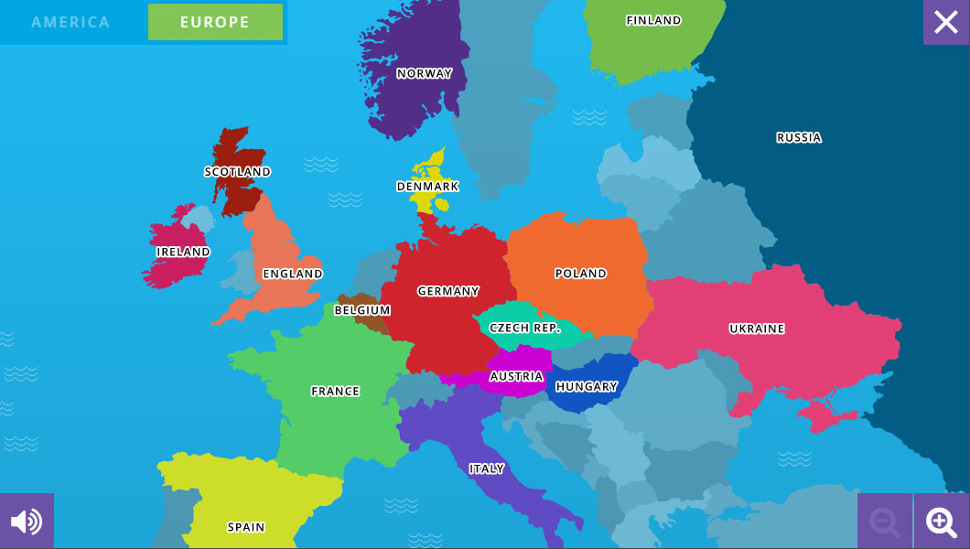
Antonin Dvorak was born in 1841
in the Czech Republic.
Image Source: http://www.antonin-dvorak.cz/images/obraz-vilimek.jpg
Image Source: https://www.classicsforkids.com/images/screencap_map.jpg

Slide 4
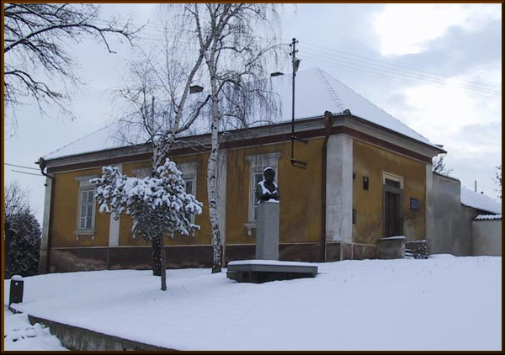
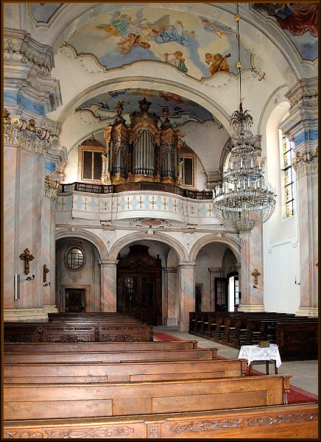
At age 12, Dvorak went to live
with an uncle
in Zlonice, Germany.
The organist’s house in Zlonice where Dvorak studied music
Image Source: http://www.antonin-dvorak.cz/images/zlonice_varhanikovna(1).jpg
His music mentor taught him
piano, viola, organ,
and beginning composition.
Interior of church in Zlonice
Image Source: http://www.antonin-dvorak.cz/images/zlonice_varhanikovna(1).jpg

Slide 5
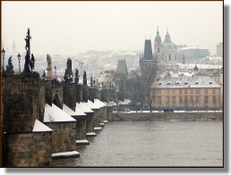
Prague
Dvorak’s home after Zlonice
Image Source: http://www.antonin-dvorak.cz/images/praha/praha_mini.jpg
At age 16, Dvorak went to Prague to study organ.
He graduated from the Prague Organ School
when he was 18 years old.

Slide 6
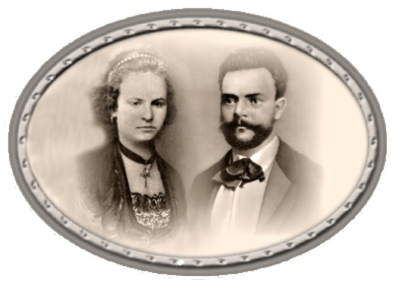
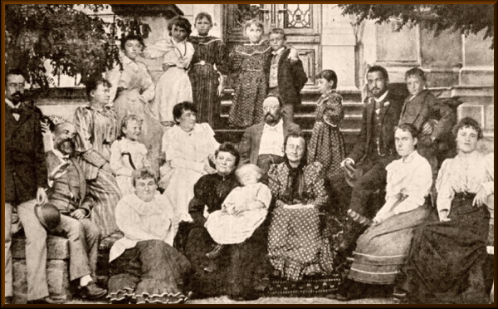
Dvorak married the sister of one
of his pupils, Anna Cermakova, in 1873.
Dvorak and his wife, Anna
Image Source: http://www.antonin-dvorak.cz/images/rodina/manzelske-foto.jpg
Dvorak and his wife, Anna, had
nine children, but three of them died
in infancy.
Dvorak (second from the left)
with his family and friends
Image Source: http://www.antonin-dvorak.cz/en/life/family

Slide 7
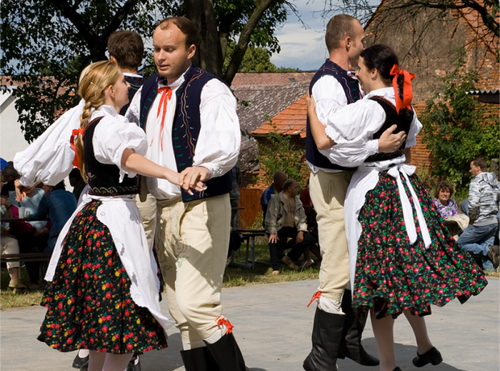
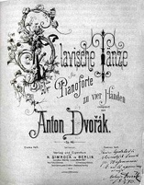
One of Dvorak’s early works was inspired
by his Czech heritage.
Slavonic Dancers
Image Source: https://assets.classicfm.com/2013/27/slavonic-dances-1373532150-view-1.png
:
Dvorak’s Slavonic Dances brought him
fame all over Europe.
The title page of the first series of Slavonic Dances
Image Source: https://en.wikipedia.org/wiki/Slavonic_Dances

Slide 8
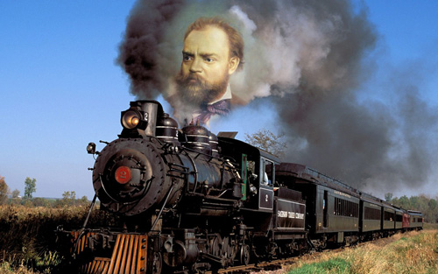
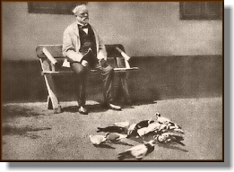
Dvorak’s new-found fame made him
uncomfortable. He preferred the privacy of
life in the country to life in a busy city.
Dvorak was obsessed with locomotives
Image Source: https://rilm.files.wordpress.com/2011/08/dvorak_train.jpg
Dvorak’s favorite hobbies were spotting trains
and keeping pigeons.
Dvorak loved to raise pigeons
Image Source: http://www.antonin-dvorak.cz/images/AD_s_holuby_mini.jpg

Slide 9
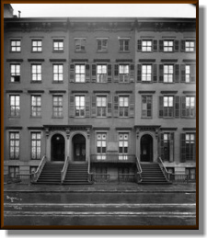
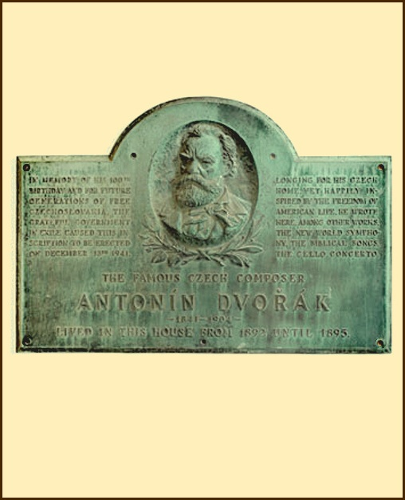
In 1892, Dvorak was invited to America to
become the Director of the National
Conservatory in New York City.
New York Conservatory in 1905
Image Source: http://www.antonin-dvorak.cz/images/konzervator_ny_1905.jpg
While Dvorak was in America, he became interested in American folk music, especially Native American music and African-American music. He used many of these musical
ideas in his “New World Symphony”.
Plaque with portrait of Dvorak in New York City
Image Source: http://www.antonin-dvorak.cz/images/pametni_deska_new_york.jpg

Slide 10
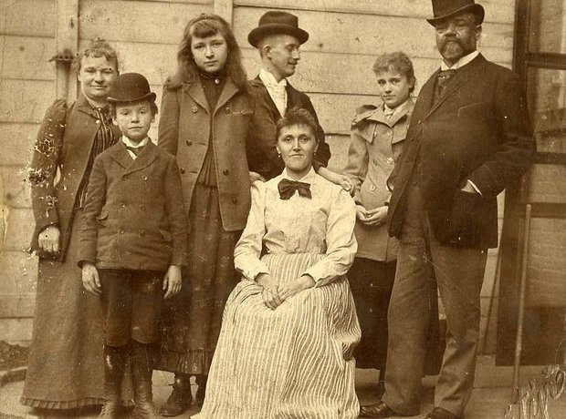
Dvorak’s family in the USA
Image Source: https://assets.classicfm.com/2013/27/dvorak-family-1373534480-view-0.jpg
Although Dvorak was very successful in America,
he was homesick and stayed only three years.

Slide 11
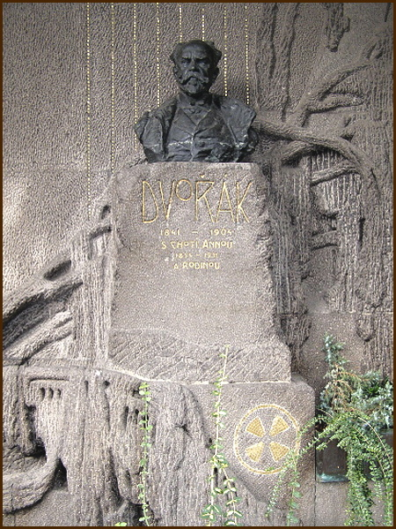
After returning to his homeland,
Dvorak served as the Director of
the Prague Conservatory from 1901
until he died in 1904.
A bust created by a Czech
sculptor marks his grave.
Bust of Dvorak in Prague cemetery
Image Source: http://www.antonin-dvorak.cz/images/busta_hrobka.JPG

Slide 12
Symphony Number 6
Movement 3
“Furiant”
Fundamental Element of Music being studied - FORM
Form is the MAP, the LAYOUT, or the BLUEPRINT for the STRUCTURE of music.
It is the overall ORGANIZATIONAL PLAN the composer creates which DIVIDES the
composition into SECTIONS that are arranged in a specific ORDER.

Slide 13
Symphony 6, Movement 3, “Furiant”
Let’s break down the FORM…
1. A SYMPHONY is divided into SECTIONS called MOVEMENTS.
2. Sometimes, the MOVEMENTS have nicknames.
3. We will be listening to Dvorak’s 6th Symphony,
the third SECTION or MOVEMENT, which is nicknamed “Furiant”.
4.“Furiant” means the music is a fiery folk DANCE from Bohemia,
which today is part of the Czech Republic.

Slide 14
Guided Viewing for Videos of Movement 3 “Furiant” of Symphony No. 6 by Dvorak
Video #1:
1. What kind of facial hair did Dvorak have in the portrait shown in the video?
2. Why is the baton blurry in the picture of the conductor?
3. In the black and white sketches of the dancers, do they look like they live in the city or in the country?
4. In the photographs of the dancers, what are the men doing with their arms?
5. What color are the rooftops in the village scene?
6. How many bridges cross over the river in the city scene?
7. In the painting of the lake, what kind of boat are the two people sitting in?
8. What time of year is depicted in the picture of the house in the country?
9. What time of day is it in the picture of the country road?
10. What is the name of the orchestra that played the music?
Link to Video #1 Dvorak: Symphony No. 6 - 'Furiant' - Jose Serebrier conducts the Bournemouth Symphony

Slide 15
Video #2:
1. Are the images still photographs or live video?
2. Is this a scene from an opera, a concert, or a ballet?
3. Is the setting a village or the city?
4. Are the people dancing wealthy or peasants?
5. Who is dancing at the beginning of the video?
6. How are the men dressed?
7. What movements do the dancers do with their arms?
8. Why are the dancers spinning and turning?
Link to Video #2:
Antonin Dvorak: Dance Movements from Symphonies 6, 7, & 8 with Ballet

Slide 16
Compare and contrast:
Compare: What is similar between the two videos?
Contrast: What is different about the two videos?

Slide 17
Form Map for Movement 3 “Furiant” from Symphony No. 6 by Dvorak
(Education Concert version has no repeats)
A | B Trio | A
Theme I 23 measures | First section 48 measures | Theme I 19 measures
Theme 2 120 measures | Second section 87 measures | Theme 2 141 measures Coda 6 measures

Slide 18
Listening Map for Movement 3 “Furiant” from Symphony No. 6 by Dvorak
A | B | A

Slide 19
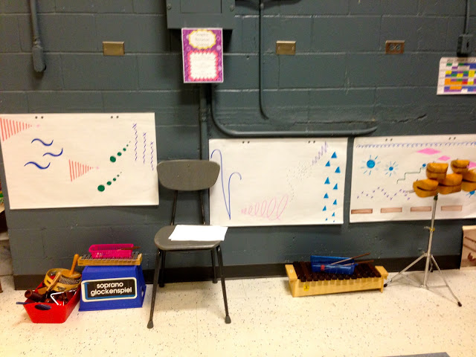
Introduction to Graphic Notation
Image Source: http://elementarymusicresources.blogspot.com/2013/05/centers-graphic-notation-station.html
Video Lesson: Creating the Graphic Score

Slide 20
Graphic Notation Map for Movement 3 “Furiant” from Symphony No. 6 by Dvorak
A | B | A
What instrument will you play? | What instrument will you play? | What instrument will you play?

Slide 21
Planning Guide for Creating Graphic Notation Map
A | B Trio | A
Theme I | First section | Theme I
Theme 2 | Second section | Theme 2 Coda 6 measures

Slide 22
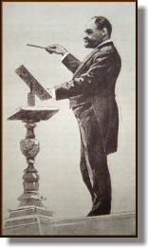
Why did you choose the one conductor’s score from your group to perform for the class?
Drawing by M.V. Nadherny of Dvorak conducting a concert of his own works at the World’s Fair in Chicago
Image Source: http://www.antonin-dvorak.cz/images/D_diriguje_v_Chicagu_kresba_M_V_Nadherny_mini.JPG

