Slide 1
North Carolina Symphony
Education Program 2021-2022
In the following presentation you will be introduced to
amazing composers who helped change the face of classical music.
Always show in presentation mode and navigate using arrows at bottom to trigger the audio and animations that are embedded on slides 2, 5, 9, 10 and 11.
Lessons created by Kim Demery
Notes:
Always show in presentation mode and navigate using arrows at bottom to trigger the audio that is embedded on slides 2, 9, and 10.

Slide 3
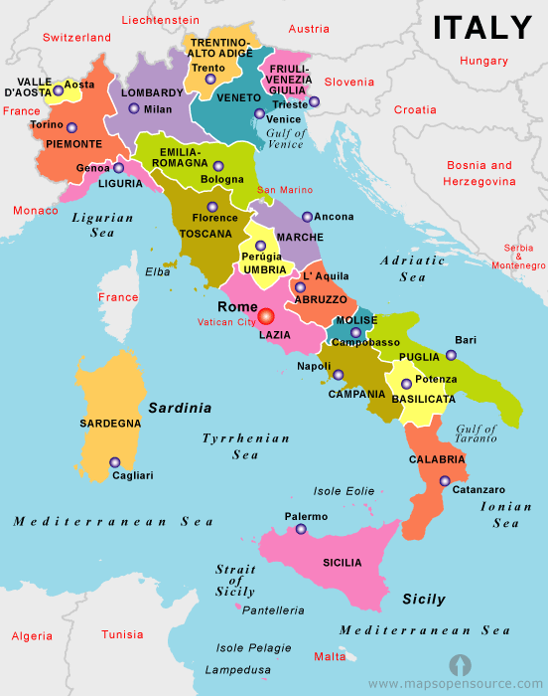
Take a trip to Italy!
Classroom Activity #1

Slide 4
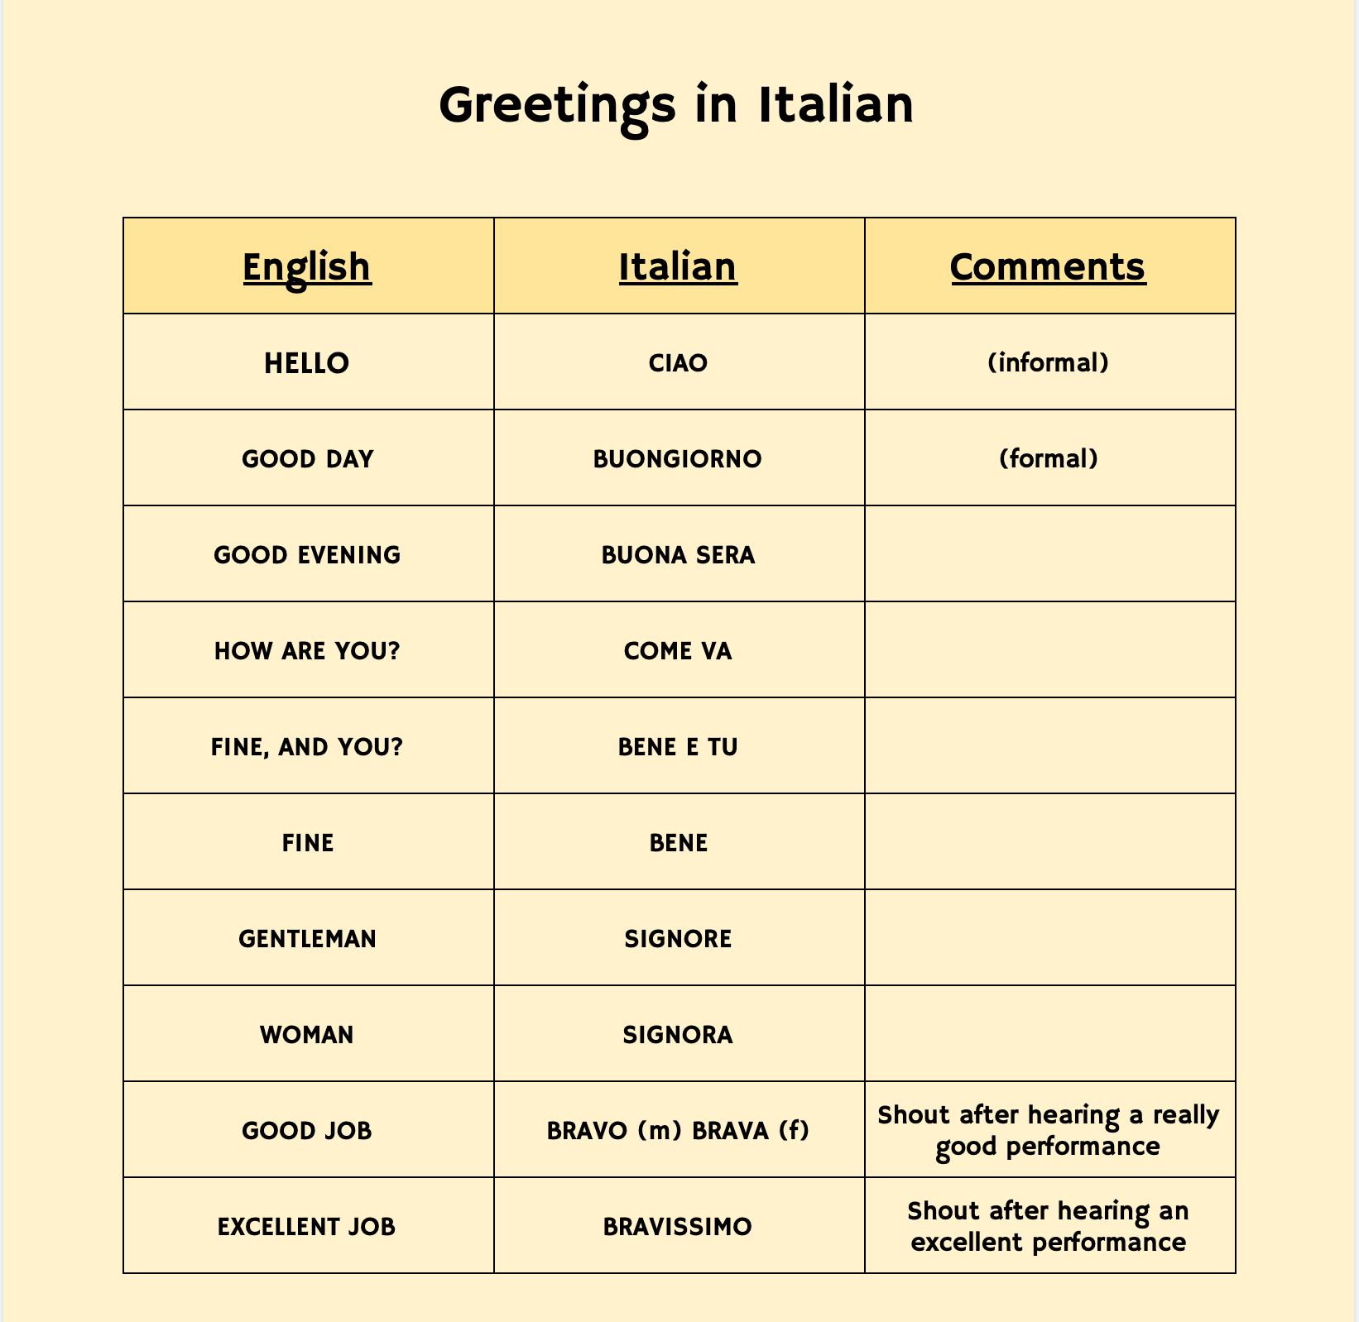
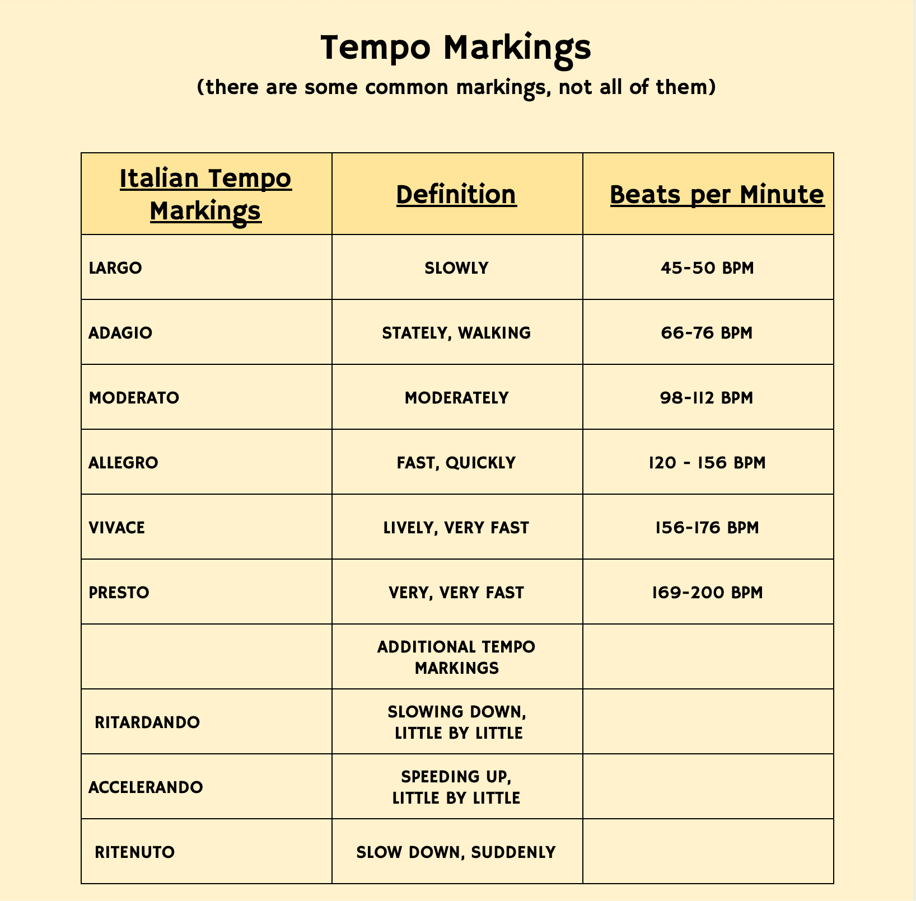
PRactice speaking Italian

Slide 5
Audio Only - Move to the Tempo!
Listen to each selection, decide if it is fast or slow
then let your body move to match the tempo.

Slide 6
About the composer

Slide 7
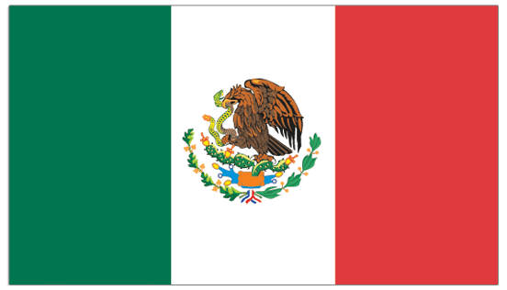
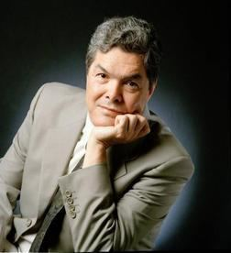
Arturo Márquez
Márquez was born in Álamos, Sonora Mexico, in 1950 where his interest in music began. Márquez is the first born of nine children of Arturo Márquez and Aurora Márquez Navarro. Márquez was the only one of the nine siblings who became a musician. Márquez's father was a Mariachi musician in Mexico and later in Los Angeles, California and his grandfather was a Mexican folk musician in the northern states of Sonora and Chihuahua, Mexico. Because of Márquez's father and grandfather, he was exposed to several musical styles in his childhood, particularly Mexican "Salon Music" which would be the inspiration for his later musical repertoire.

Slide 8
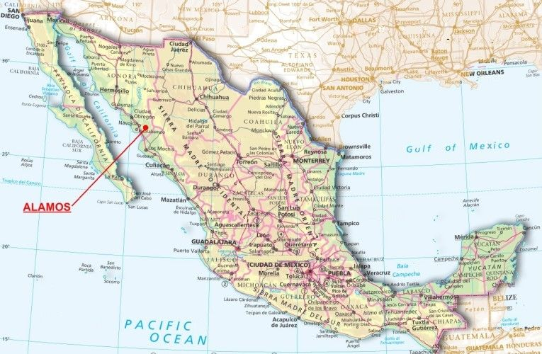
Map of Mexico
Alamos, Sonora

Slide 9
Vocabulary
Danzón - the official music and dance style of Cuba. It is also a loved style of music and dance in Mexico and Puerto Rico. The Danzón is usually written in 2/4 meter and is a slow partner dance with required footwork and pauses around syncopated beats. The Márquez Danzon #2 is written in the style of the Salon Music of Mexico.

Slide 10
Arturo Márquez discusses his Danzón #1 and #2 with LA Philharmonic Conductor Gustavo Dudamel
Dancing the Danzón

Slide 11
Composer
Born 1950 ~ Álamos, Sonora Mexico

Slide 12
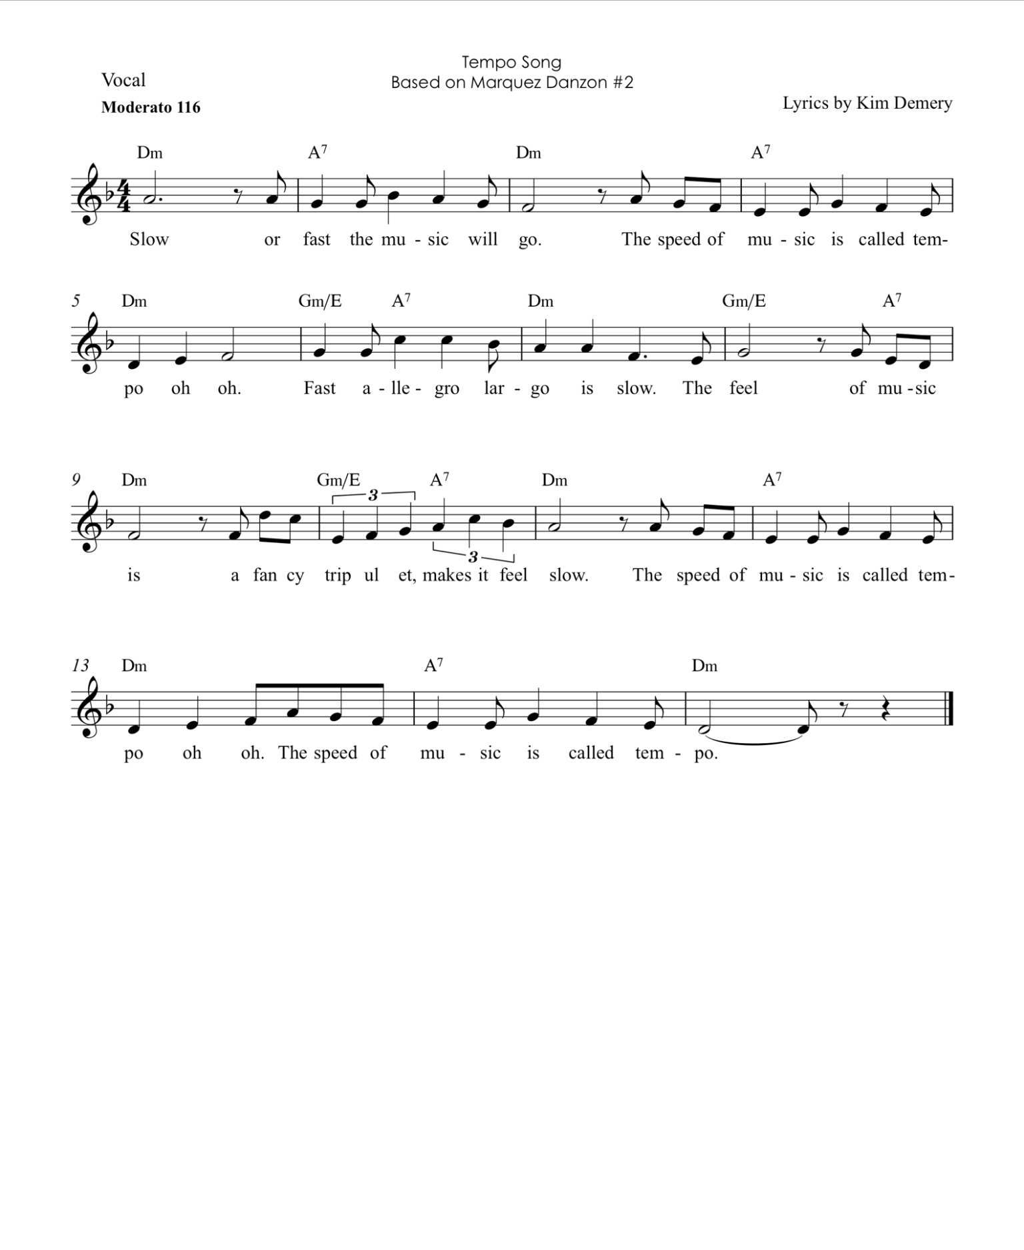
Lesson Activity #2
Sing the “Tempo Song”. Do you recognize the main theme from Danzón?
Try singing at different tempos. Largo = 60 BPM
Presto = 160 BPM
How does this change the mood of the song?

Slide 13
Additional Resource Videos
Basic Danzón Step Tutorial
Mr. Henry - What is Tempo?
The Music Show Episode #6
Presto is Fast, Largo is Slow
Music K-8 Presto Largo

Slide 14
Thank you for participating in the NC Symphony Education Program.
We hope you enjoyed the music!

